Slide 1
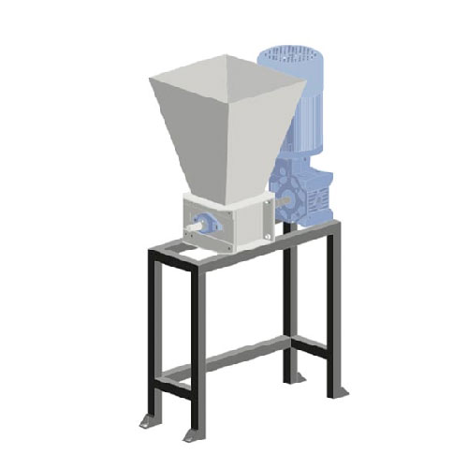
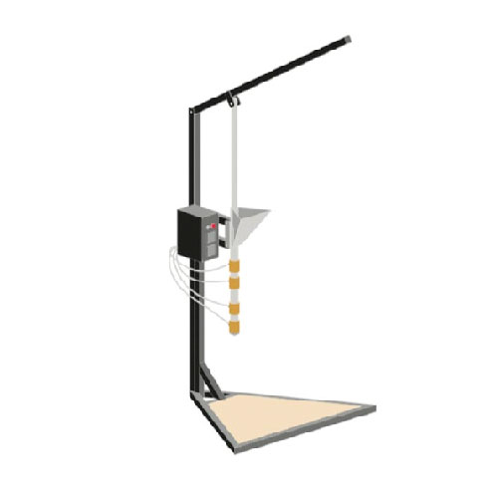
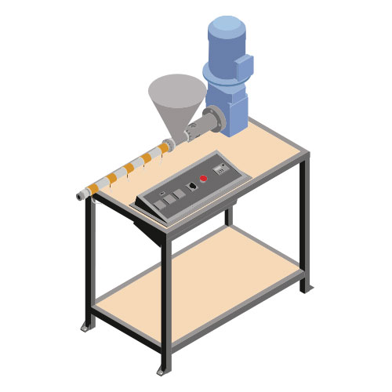
The Shredder
Generating items from waste plastic involves 3 steps.
Shredding of the plastic into smaller parts.
Melting the shredded plastic.
Pumping the melted plastic into a mould and letting it set.
The Injection Moulder
The 3 Machines
The Shredder – Breaks larger plastic objects down into small parts, easier and more consistent to melt
The Injection Moulder – Both melts the plastic and moulds it, producing more intricate 3D items.
The Extrusion Moulder – Melts the plastic and moulds to produce a beam of specified shape, can be 2D, or 3D.
The Extrusion Moulder

